Slide 1
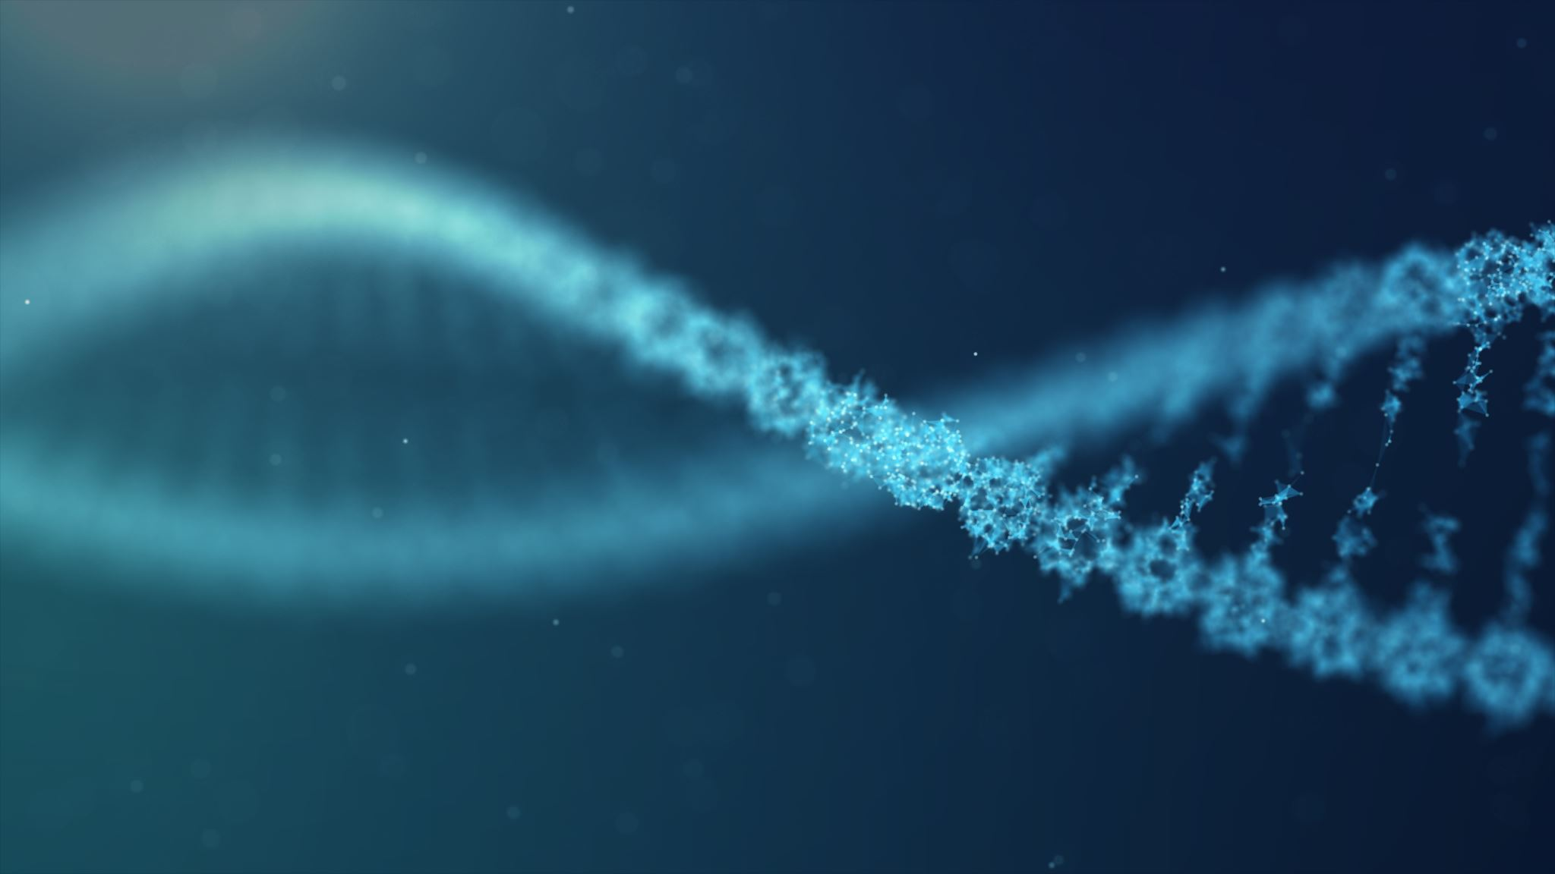
Text Search
A model to turn an image into text

Slide 2
Motivation
There are many textual documents stored as images
These documents are harder to process.
Being able to transform an image into text will enable…
The ability to search for keywords.
The ability to translate documents using a program like google translate
The ability to store data generated by people with handwritten documents

Slide 3
The Goal
Create a proof of concept that it is possible to create a model to transform images into text.
Dependencies
Tesseract – splits up characters in a document.
Wherever Tesseract fails to perform properly is out of scope for this project
Keras – creates a CNN
The Data
28 x 28 images of individual characters compiled on Kaggle from an NIST dataset

Slide 4
The data
372451 pictures of characters
28 X 28 white char on black background
The pics per letter is not distributed evenly.
Sample letter

Slide 5
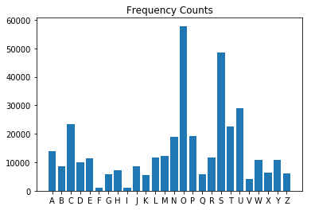
Distribution of letters
The most common letter is an ‘O’,
and the lest is an ‘I’
This does not follow the distribution found in most text documents
This should not effect the model since there are still 1000 images of each.

Slide 6
Preparing the Data
Tesseract does not always leave the char in the middle of the image.
Augmentation was used so that the model would be able to predict chars off center; images were shifted up to 20 percent up/down/left/right randomly.
Data has white chars on black background, but in most cases, chars are black on white background
Half of the images on the training set were inverted (black becomes white and white becomes black)

Slide 7
Generating the model.
Split up into training and test set
Used a Convolutional Neural Net
2 Convolution layers applying a 3 X 3 filter, multiplying each pixel by the matrix
RELU Activation function to avoid linearity
Flattening layer
Dense layer where each node votes which of the 26 chars it should be
Model picked up angle of lines to predict the correct letter
Achieved .9660 accuracy on training data and .9652 on test data

Slide 8
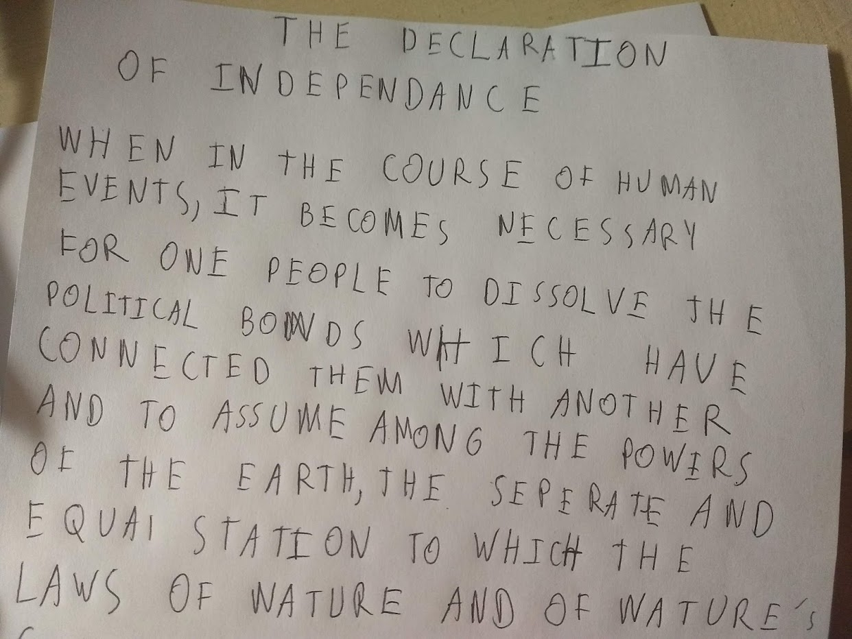

Moving from Model to Application: Input
An image with text is the input
Here, the declaration of independence is used as an example
Tesseract is used to split the image into individual chars
Sample letter generated by Tesseract
The original input

Slide 9
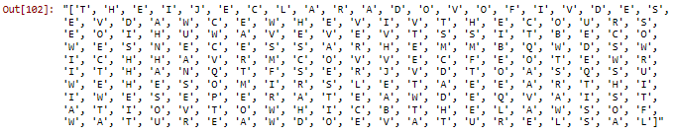
Moving from Model to Application Continued
The model predicts on these individual chars
Final Output
Original Input

Slide 10

The model is not perfect…
Certain letters like M, V, and W which all have diagonals meeting at sharp points get confused.
The model can’t predict letters that Tesseract poorly divides.
This makes it hard to give a number to depict how accurate the model can predict on new documents
Tesseract keeps these letters together even though they are two separate chars, a ‘T’ and an ‘I’

Slide 11
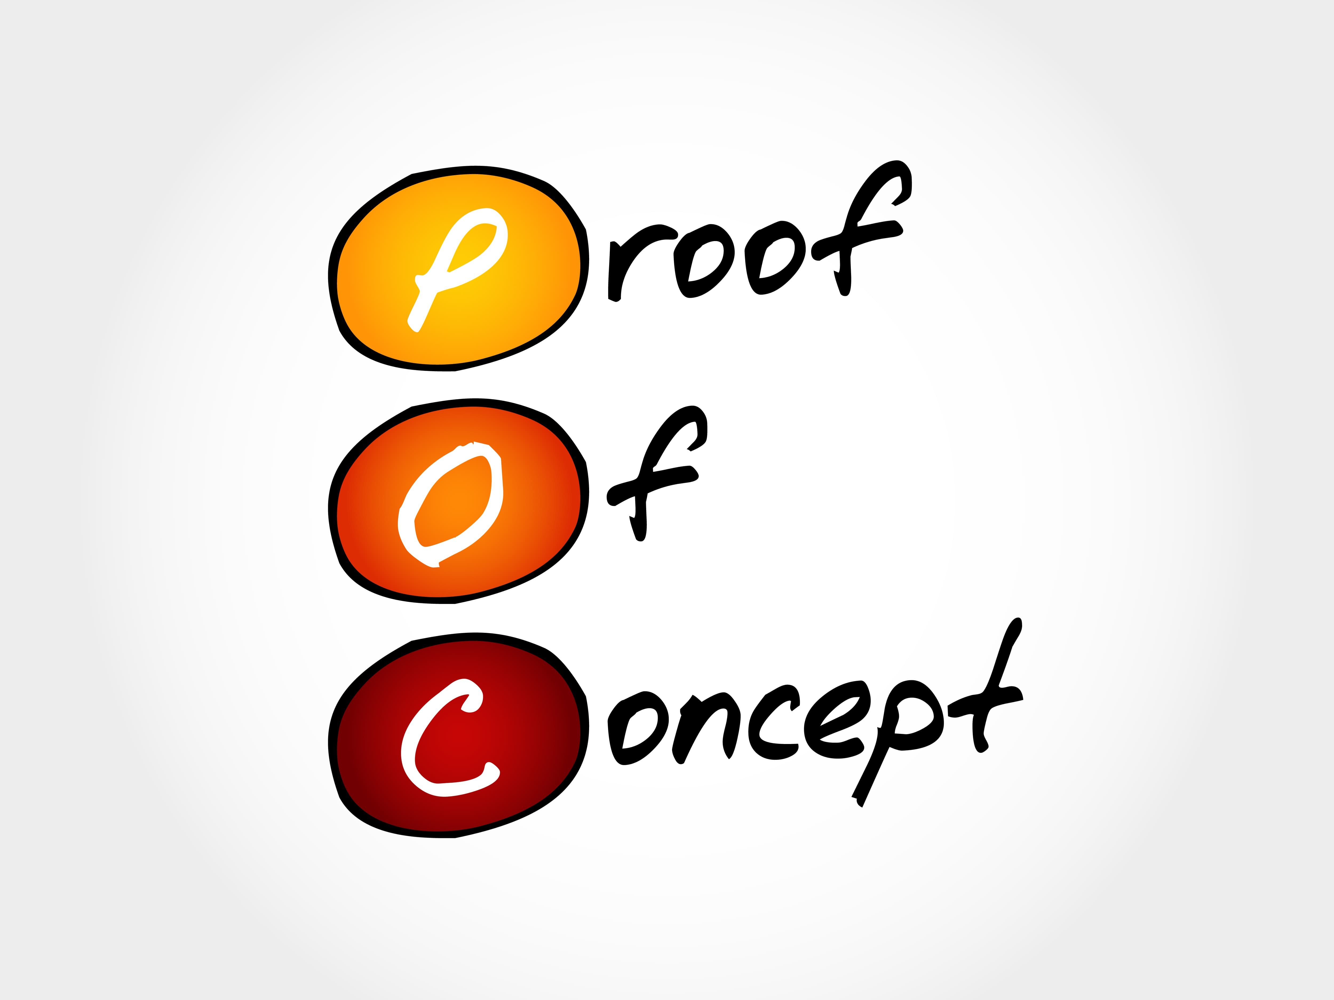
The positive
For the most part, the model was able to accurately predict the correct letters.
Even in cases where the model didn’t predict accurately, the correct letter was always one of its top 5 predictions (except where Tesseract did poorly)
The model was not confused with predicting black text on white background, even though the text input was black text on white

Slide 12

Future Enhancements
Train the model to include lower case letters and perhaps other languages
Make the model more complex so as not to get confused between letters coming to sharp points
Build an API for applications to use this model on text images.

